Slide 1


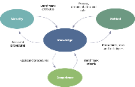




Navigation
Processes
Knowledge
Documents
Resources
Local

Slide 2
Processes and phase gates
Process model
With the exception of sponsorship, these processes are each designed to manage a phase of the project life cycle.
While all projects and programmes broadly follow the same life cycle, different contexts require adaptation and tailoring of the basic processes.
Library
The pages linked from this diagram should be regarded as starting points from which organisational specific activities and practices can be developed.
Navigating Praxis
Tailoring Praxis
Application
Team Praxis
Sponsorship process
No
No
Benefits review
Request for authorisation
Request for authorisation
Yes
Yes
Mandate
Identification process
Brief
Definition process
Definition documentation
Delivery process
Closure process
Outputs
Benefits realisation process

Slide 3
Identification process
Goals
This process manages the first phase of the project life cycle. Its goals are to:
• develop an outline of the project and assess whether is it likely to be justifiable;
• determine what effort and investment is needed to define the work in detail;
• gain the sponsor’s authorisation for the definition phase.
Application
Identification process
Competence
Prepare brief
Maturity
Assessment
Appoint identification team
Review previous lessons
Request for authorisation
Resources
Mandate
Checklist
Prepare definition plan
Overview
This process will be triggered by a mandate. The first goal is addressed in the form of the brief and the second in the form of the definition plan (a form of delivery plan). At the end of the process these two documents will be presented to the sponsor with a request to authorise the definition process.
The first activity is the appointment of an identification team. This will comprise a manager and sponsor as a minimum, plus as many specialists as are required to match the scope and complexity of the work.
The identification team should identify any lessons learned that they can beneficially apply to the current project or programme.
The main part of this process is then the preparation of the brief and plan for completing the definition phase. These two documents will be submitted to the sponsor who will decide whether investment in the definition phase is worthwhile.
Authorisation
Definition process
Sponsorship process
Key functions
Most functions will be used at a relatively high level in order to produce the brief and definition plan. The main functions used will be:
Schedule management
Risk management
Organisation management
Stakeholder management
Scope management

Slide 4
Sponsorship process
Goals
This process is designed to achieve the goals of the sponsorship function, i.e. to:
Application
Identification process
Appoint identification team
Competence
• provide ownership of the business case;
• act as champion for the objectives of the project;
• make go/no go decisions at relevant points in the life cycle;
• address matters outside the scope of the manager’s authority;
• oversee assurance;
• give ad-hoc support to the management team.
Maturity
Assessment
Resources
Checklist
Sponsorship process
Review request for authorisation
Provide management support
Oversee assurance
Confirm closure
Review achievement of business case
Overview
This process comprises five independent activities.
Requests for authorisation occur at the end of a phase or stage where the sponsor has to decide whether the work continues to be worthwhile.
Escalations arise when issues are outside of the manager’s scope of authority and informal requests for help can arise at any time.
Request for authorisation
Escalation or informal request
Assurance
Request for closure
Benefits review
Assurance that the work is being managed efficiently and effectively is a constant responsibility of the sponsor although the detail of conducting assurance reviews will be delegated.
When a request for closure is submitted the sponsor must confirm that the management infrastructure may be demobilised.
Where appropriate, after changes have been embedded and benefits achieved, the sponsor must oversee a review of actual benefits as compared to the agreed business case.
Key functions
Sponsorship
Leadership
Delegation
Communication
Conflict management
Influencing
Assurance
Business case management

Slide 5
Definition process
Goals
This process manages the definition phase of the project life cycle. Its goals are to:
Application
Request for authorisation
No
Closure process
Competence
Maturity
• develop a detailed picture of the project;
• determine whether the work is justified;
• describe governance policies that describe how the work will be managed;
• gain the sponsor’s authorisation for the delivery phase.
Assessment
Definition process
Yes
Resources
Authorised brief
Appoint definition team
Prepare governance documents
Checklist
Consolidate definition documentation
Mobilise
Delivery process
Define scope
Plan delivery
Overview
This process starts when the brief and definition plan produced by the identification process are approved.
The first activity is to assemble the team that will complete the definition activities. This team starts by defining the scope of the work, which will inform decisions about how it should be managed, e.g. as a project or a programme; using predictive or agile approaches.
This will lead to the preparation of the governance documents and high-level delivery plans. There may also be some preparatory work that should be started early, accepting the risk that this may be wasted if the project or programme delivery is not approved.
The consolidated definition documentation is submitted for approval to the sponsor and if authorisation is given, resources are mobilised for the first stage of delivery.
Pre-authorisation work
Key functions
All relevant functions will be used at a high level in order to produce the definition documentation. The main functions used will be:
Schedule management
Risk management
Organisation management
Scope management
Resource management
Stakeholder management

Slide 6
Delivery process
Goals
The goals of delivering a project are to:
delegate responsibility for producing deliverables;
monitor the performance of the work and track against the delivery plans;
take action where necessary to keep work in line with plans;
escalate issues and replan if necessary;
accept work as it is completed;
maintain communications with all stakeholders.
Request for authorisation
Escalation
Application
Competence
Exception plan
Maturity
Assessment
Delivery process
Resources
Checklist
Corrective action
Update and communicate
Closure process
More detail
Authorisation
Development process
Overview
The delivery process is what controls the creation of the products and deliverables that collectively comprise the scope of work.
Once the first stage of delivery work has been authorised, the project manager will identify the work packages to be performed. This will be delegated to the relevant teams who will report back on progress. The project manager will co-ordinate the teams and accept completed work once it has met quality control standards.
Throughout the progress of the work, delivery documents will be updated, e.g. schedules, budgets, risk registers etc. Communications with stakeholders and between teams will be performed in accordance with the communications plan.
Authorise work
Co-ordinate and monitor progress
Accept completed work
Boundaries process
As the work progresses issues may occur that cannot be easily resolved by the manager, who then escalates these to the sponsor for resolution. In some cases, an issue may require the production of an exception plan that demonstrates how an issue will be resolved and how the schedules and budgets will change. An exception plan should be submitted to the sponsor for authorisation as part of the sponsorship process.
Key functions
Library
Assurance
Communication
Delegation
Control
Shewhart cycle

Slide 7
Benefits realisation process
Goals
It is usually the case that simply producing an output does not automatically realise benefits. In most cases an output is used to change some aspect of an organisation’s mode of operation or environment. The goals of this process are to:
establish the current state of what is being changed;
co-ordinate the delivery of outputs with the management of change;
ensure changes are permanent;
establish whether benefits have been achieved.
Application
Competence
Benefits realisation process
Maturity
Prepare for transition
Manage transition
Conclude transition
Final review
Overview
Benefits are usually achieved through organisational or societal change. This process address the transition from an existing state to a future state that uses outputs to deliver benefits.
The activities follow a simple and well-established model for the management of change.
Firstly, the preparation work must be done to ensure that people, processes and infrastructure are in place to make use of the outputs of the delivery process. This also involves addressing any resistance to change.
Secondly, the outputs are introduced, people are helped and encouraged to adopt new behaviours, attitudes and working practices.
Thirdly, the changes are supported longer term to ensure they become ‘business-as-usual’, i.e. they are no longer seen as new and become embedded in the culture.
Finally, at a suitable point, the effect of the changes is reviewed and the resulting benefits are valued. This is compared to the original business case to provide one measure of the success of the project.
Key functions
Benefits management
Change management

Slide 8
Closure process
Goals
The goals of this process are to:
close a project that has delivered all its outputs;
close a project that is no longer justifiable;
review the management of the work and learn lessons.
Application
Request for closure
Competence
Maturity
Assessment
Closure process
Checklist
Prepare for closure
Hand over
Demobilise
Overview
This process is where the temporary organisation set up to execute a project or programme is closed down and the outputs of the delivery process are handed over to their long-term owners.
Once the end is in sight, the project team will prepare for closure. This could involve notifying stakeholders, selling off assets and demobilising staff. It will also include the finalisation of any contracts let.
Individual deliverables may be handed over to their owners throughout the delivery process. The final hand over confirms that the overall product is complete and the new owner takes full responsibility for its operation.
The conduct of the project or programme will be reviewed and lessons recorded to be used when setting up the next project or programme. Note: this is not the same as the final review in the benefits realisation process which reviews the success of the business case.
Review
Before the final demobilisation of the project or programme organisation, the sponsor is asked to confirm that this may be done. This activity should also include the closure of budgets and a final calculation of the cost of the work.
Key functions
Resource management

Slide 9
Documentation
More detail
Documents fall into three categories: governance, scope and delivery.
Governance documents set out policies, standards and guidelines for the management of the work. Some of these may be specialist documents provided by the host organisation, a client or a regulatory body. Praxis only deals with the management plans that reflect how elements of P3 management will be managed.
Scope documents describe the objectives in terms of outputs, outcomes and benefits.
Delivery documents are the largest and most diverse group. They describe what needs to be done, when it will be done and by whom. They also support the management processes and procedures.
Configuration management
Key functions
Information management
Library
Templates

Slide 10
Management plans
These documents set out the way a function will be managed. The two main sections cover the policy and procedure of the function with the detail being adapted to the context of the work. This is distinct from a delivery plan, which explains the detail of how a specific piece of work will be delivered.
Policy includes sections on roles and responsibilities, information management, assurance, budget and interfaces to other functions.
Procedure begins with defining the steps to be used in performing the function, followed by detailed recommendations on the tools and techniques to be used in each step.
Management plans are created according to the needs of the work. If appropriate functions may be merged into one plan or a function may be sub-divided.
There is a danger that the following list of management plans appears highly bureaucratic and time consuming to prepare. The principle is simply that there are many functions that need to be managed and it is important to think about how that will be done. The range and detail of management plans should be consistent with the complexity of the work.
Links in this table are to the Praxis Framework web site, where blank and annotated templates are available.
Organisation management plan | Benefits management plan
Stakeholder management plan | Schedule management plan
Control management plan | Finance management plan
Information management plan | Risk management plan
Assurance management plan | Change management plan
Scope management plan | Resource management plan

Slide 11
Scope documents
Scope documents describe the objectives of the work. In many cases it is possible to define standard documentation that is independent of the environment, e.g. a business case or benefit profile. In others, the content is entirely dependent upon the technical nature of the work and so Praxis simply describes what is to be achieved by the document but cannot define any detail, e.g. a specification.
The standard scope documents in Praxis are:
Links in the ‘Title’ column of these tables are to the Praxis Framework web site.
Title | Content
Mandate | The mandate is the ‘document’ that triggers the start of the identification process.
Vision statement | The vision statement is a means of communicating the essence of the work to stakeholders.
Specification | Specifications define outputs and are created by the solutions development procedure.
Product documents | The extent and detail of product documentation is very dependent upon the context of the work. Praxis provides a list of fields from which suitable documents should be constructed.
Blueprint | A blueprint is a form of specification. It is applicable to programmes of business change where the ultimate objective is a changed organisation and working methods.
Title | Content
Benefits map | A benefits map is needed where there are complex relationships between multiple outputs, benefits and the strategic objectives.
Benefit profile | A benefit profile is used to define both benefits and dis-benefits.
Business case | The business case is the central document to a project life cycle. It describes the expected value of benefits and confirms their desirability, achievability and viability.
Brief | The brief is created by the identification process and is one of the documents submitted to the sponsor to seek approval to start the definition process.

Slide 12
Delivery documents
While the management plans set out the governance principles for how the work will be managed and the scope documentation defines what should be achieved, the delivery documents are at the heart of actually doing the work.
Which delivery documents are to be used and what their format will be, is defined in the management plans. They are primarily used in the delivery, development and boundaries processes.
Delivery documents are the most dynamic of the three documentation groups and should be maintained in accordance with the principles of information management and configuration management.
Links in the ‘Title’ column are to the Praxis Framework web site.
Title | Content
Definition plan | Alongside the brief, this is submitted to the sponsor to seek approval for the definition process.
Communication plan | A form of delivery plan focused on communication with stakeholders.
Stakeholder register | The stakeholder register records information about individuals and groups who have an interest in the work being performed.
Risk register | The risk register records information about identified risk events.
Delivery plan | Delivery plans come in various shapes and sizes, e.g. a definition plan or a communication plan. It is useful for all these to follow a consistent format.
Issue register | This register records all problems that need to be escalated from one level of management to another.
Title | Content
Lessons log | A lesson log captures relevant previous lessons learned and records new lesson learned.
Daily log | A daily log is a personal document that records informal information not stored in any of the other defined documentation.
Change log | The change log records requests for change and their progress through the change control procedure.
Progress report | Reports on progress at regular intervals.
Event report | Reports on progress at specific events.
Follow-on actions report | This report lists the actions that remain outstanding when the project team is demobilised.

Slide 13
Knowledge
Overview
This section is so named because it aligns with guides that are frequently referred to as ‘Bodies of Knowledge’. The aim is to define the building blocks of the discipline of P3 management and is based on the concept of a functional analysis. The functions described in this section are split between context and management.
Contextual functions are not directly responsible for achieving project objectives but are part of the context which supports that endeavour. Only selected topics from this section are included in Praxis Local.
Management functions are the ones that are applied in the completion of projects.
The knowledge section integrates with all the other sections of Praxis. Each function describes the procedures, tools and techniques that can be used in management processes. In return the method section provides a structure for the use of the functions within the life cycle.
Selected contextual functions
Life cycle
Sponsorship
Support
Top level management functions
Organisation management
Stakeholder management
Business case management
Planning
Control
Information management
Scope management
Benefits management
Schedule management
Financial management
Risk management
Change management
Resource management
Assurance
Interpersonal skills

Slide 14
Life cycle
Goals
A P3 life cycle illustrates the distinct phases that take an initial idea, capture stakeholder requirements, develop a set of objectives and then deliver those objectives.
The goals of life cycle management are to:
• identify the phases of a life cycle that match the context of the work;
• structure governance activities in accordance with the life cycle phases.
Application
Output
Resources
Gates
Idea
Identification
Definition
Delivery
Closure
Benefits realisation
Long term benefits
Overview
It all starts with someone having an idea that is worth investigation. This triggers high level requirements management and assessment of the viability of the idea to create a business case. At the end of the phase there is a gate where a decision made whether or not to proceed to more detailed (and therefore costly) definition of the work.
If the idea is good enough, the work will continue to a detailed definition that produces a full justification for the work. Once again this ends in a gate where a decision is made whether or not to proceed to the delivery phase. Once the output has been produced it is usually subject to an acceptance process before being formally delivered to its new owner. The life cycle comes to an end with the closure of the project.
All outputs are intended to deliver benefits and this can be shown as a final phase although it will often work partly in parallel with delivery.
The phased structure of life cycles facilitates the creation of governance mechanisms, such as:
• Defined processes – the management of each phase can be described as a process made up of a number of relevant activities.
• Stages and tranches – the delivery phase can be subdivided into packages of work, typically called stages in a project and tranches in a programme.
• Gate reviews – these are conducted at the end of a phase, stage or tranche. The sponsor will consider performance to date and plans for the next phase, stage or tranche before deciding whether the business case remains viable, practical and achievable.
• Post-reviews – learning from experience is a key factor in maturity. Post-project reviews document lessons learned for use in the future.
• Benefit reviews – these measure the achievement of benefits against the business case.

Slide 15
Sponsorship
Sponsorship provides ownership of, and accountability for, the business case and ensures that the work is governed effectively.
The goals of sponsorship are to:
provide ownership of the business case;
act as champion for the objectives of the project;
make go/no go decisions at relevant points in the life cycle;
address matters outside the scope of the manager’s authority;
oversee assurance;
give ad-hoc support to the management team.
There are various names given to the role that provides sponsorship, such as: executive, senior responsible owner or client. In Praxis the role is referred to as the sponsor.
A common failure in less mature organisations occurs when the role of sponsor is not taken seriously. It must be an active role fulfilled by someone who is committed to performing the activities set out in the sponsorship process.
It will depend upon the context of the work whether sponsorship is provided by an individual alone or with the support of others.
Where a sponsor is supported by other managers they are commonly referred to as a project board. Within a board the sponsor retains ownership of, and accountability for, the business case.
While the sponsor’s primary role is to ensure that the business case continues to justify the work throughout the life cycle, this would not be possible without an effective working relationship with the project manager. To the extent that, if the business case ceases to justify continuing investment, the sponsor needs to work with the manager to redefine or prematurely close the project.
The sponsor usually has responsibility to others within the host organisation or perhaps an external client. This responsibility includes ensuring that the work is being managed effectively. The sponsor does this through assurance, which is an independent review of the management of the work.
A sponsor must be someone who:
has the credibility to provide leadership that crosses corporate and departmental boundaries;
is genuinely enthusiastic about the objectives of the project;
is able and willing to commit time and energy to the fulfilment of the role.
Application
Competence
Maturity
Assessment
Resources
Checklist
Team Praxis
See also
Organisation management
Business case management

Slide 16
Support
Support is a set of specialist and administrative services carried out on behalf of project managers. A support infrastructure can be constituted in many different ways with many different roles within the realm of P3 management. A definitive set of goals for support is impractical but they are generally drawn from the broad list shown below:
provide administrative support to P3 managers;
support the governance of P3 management;
provide specialist technical support;
conduct assurance.
Routine administration is required on all projects. On small projects this may be performed by the project manager, but on medium to large projects a manager needs support in handling day-to-day administration.
An administrative support function can operate at different levels depending upon how it is constituted. It may provide:
administrative help in areas such as planning, risk management, etc.;
the secretariat for meetings and logistical services;
technical support including collecting, analysing and presenting progress information;
assurance of governance structures and standard P3 management practices through audits, health checks and phase end reviews.
A more sophisticated support function may also cover:
provision of subject matter expertise to ensure that there is access to all necessary tools and techniques;
training, coaching and mentoring for the project management team;
maintaining the infrastructure, momentum and drive to support communities of practice;
improving, embedding and measuring capabilities to achieve higher levels of maturity;
owning and deploying standard tools and techniques.
The P3 support infrastructure may range from a single person to a large team containing many different roles and specialists. The overall infrastructure may be divided into multiple offices, some temporary and some permanent. For example, a support office might provide administrative support to a specific project.
This is then disbanded once the work is complete. In contrast, an organisation wide support office has a permanent support role independent of the creation and completion of any individual piece of work.
Application
Maturity
Assessment
Resources
Checklist
See also
Organisation management

Slide 17
Organisation management
Goals
Organisation management is concerned with creating and maintaining a management structure applicable to the project and the context in which it operates. Its goals are to:
design an organisation appropriate to the scope of work to be managed;
identify and appoint members of the management team;
maintain and adapt the organisation throughout the life cycle.
Procedure
Application
Competence
Maturity
Plan
Initiate
Maintain
Close
Assessment
Resources
Checklist
Overview
Planning for organisation management includes the design of an organisation structure that will match the context and scope of the work. This will include the description of policies for appointing staff and cross-reference the relevant host-organisation HR policies.
The initiate step involves making appointments and delivering any necessary training.
The demands on the organisation structure will usually change during the course of the project life cycle. The organisation must be amended to take these changing requirements into account.
Finally the organisation is closed down and disbanded.
The organisational structure of individual projects will vary according to the context and specific needs of each situation. In broad terms, the organisation will always have four main levels as shown opposite.
Generic structure
External
Sponsorship
Management
Assurance
Support
Delivery

Slide 18
Stakeholder management
Goals
Stakeholder management ensures that stakeholders are appropriately involved in all aspects of the project. Its goals are to:
• ensure that the views and attitudes of all stakeholders are understood;
• influence stakeholders to be supportive of the work wherever possible;
• maximise the impact of supportive stakeholders;
• minimise the impact of unsupportive stakeholders.
Plan
Initiate
Application
Competence
Maturity
Assessment
Resources
Identify
Assess
Engage
Checklist
Plan communications
Team Praxis
Overview
Stakeholders are individuals or groups with an interest in the project because they are involved in the work or affected by the outcomes.
Most projects will have a variety of stakeholders with different and sometimes competing interests. These individuals and groups can have significant influence over the eventual success or failure of the work.
Working with stakeholders is a vital component of many functional procedures. For example, requirements management is based on stakeholders’ wants and needs, and risk context (and therefore risk management) is based on understanding stakeholder appetite for, and attitude to, risk.
Identifying stakeholders and understanding the relationships between their different areas of interest is usually achieved through stakeholder mapping.
Library
Detailed stakeholder maps will assess each stakeholder in terms of their interest in the work and influence over the way it is performed.
Once the stakeholders have been assessed, plans can be put in place to communicate with them with a view to influencing their interest and influence.
Plans for communication with stakeholders who have high levels of interest and influence will be different from those who have low levels interest and influence.
Communications planning identifies the ideal people to engage with each stakeholder.
Stakeholder management becomes more complex when stakeholders’ views, roles or allegiances etc. change throughout the life cycle. For that reason, the stakeholder management steps must be repeated throughout the life cycle.
Stakeholder mapping

Slide 19
Business case management
Goals
Business case management is the function concerned with developing, communicating and maintaining the business case. Its goals are to:
summarise context and delivery in a single document;
explain the desirability, achievability and viability of the proposed work;
develop the primary document that will be used to support a ‘go/no go’ decision at all gates in the life cycle;
update and maintain the business case throughout the life cycle.
Application
Competence
Unlike most other delivery functions there is no procedure to describe the development of the business case. Its development sequence is adequately covered by activities in the Praxis process model.
Maturity
Assessment
Resources
Checklist
Team Praxis
Overview
All projects must have a business case that demonstrates the value of their objectives.
In the identification process an outline business case is incorporated into the project brief that is used by senior management to assess whether to give the go-ahead for the definition process. A detailed business case is prepared during the latter process and then used to decide whether full approval for the work should be given.
Once approved, the business case must be kept up to date, reflecting approved changes. In this way, it can be used as the primary document at gate reviews (e.g. at the end of a tranche or stage) to determine if the work should continue.
A business case typically includes three sections:
context – the background of the project and why it is needed;
delivery summary – a top level view of the stakeholders, scope, schedule, finance, risk, resource and change involved;
justification - an explanation of why the work should be undertaken.
More detail
Justification comprises three tests, i.e. is the work:
Desirable: this is determined from requirements management which demonstrates that the objectives of the work are required by the stakeholders.
Achievable: benefits management defines achievable benefits, solutions development specifies achievable outputs and planning establishes the practicality of the work (within any time and resource constraints).
Viable: investment appraisal assesses the financial return on investment and risk management assesses the exposure to risk in performing the work.
The business case is owned by the sponsor, who has ultimate accountability for ensuring that the benefits are achieved.
Investment appraisal
Requirements management
Solutions development
Library
Payback method
Discounted cash flow
Value management

Slide 20
Planning
Goals
Planning occurs broadly at two levels: governance and delivery.
The goals of management plans used in governance are to:
describe the principles that should be used to manage the work;
provide consistency with flexibility across multiple projects.
The goals of delivery planning are to:
describe the objectives of the project;
define the work required to achieve the objectives and describe how it will be performed
estimate the resources and finance needed to perform the work:
document the plans and update them throughout the life cycle.
Delivery plans address seven questions:
Why? Everyone involved in, or affected by the work should understand why it is being done.
What? The work will be described as outputs, outcomes and/or benefits in documents such as a specification, blueprint or benefit profile.
How? The best way to deliver the objectives is embodied in many detailed delivery plans.
Who? This covers the management organisation and the delivery resources as defined in organisation management and resource management respectively.
When? Schedule management determines the timing of milestones, stages, tranches, work packages and individual activities.
Where? While many projects are located in one physical location, more complex projects are spread across many locations and often time zones.
How much? Naturally, the cost of the work is an essential component of the business case. Financial management determines how much the work will cost and how it will be funded.
Application
Competence (governance)
Competence (delivery)
Resources
Team Praxis
Library
Estimating techniques
Overview
At the governance level a series of management plans sets out the principles of how each aspect of the work will be managed. These plans include documents such as the risk management plan, scope management plan and financial management plan.
These governance-level plans set out policies and procedures for each aspect of management. They list preferred techniques, including templates for documentation and defined responsibilities.
These plans ensure the quality of the P3 management processes and deliverables. Therefore, developing the governance-level plans could also be termed ‘quality planning’.
Value management
Key processes
Management plans are produced in the definition process.
Delivery plans are first produced in the definition process and then maintained throughout the life cycle.

Slide 21
Control
Goals
Control involves monitoring performance against approved baselines, updating delivery documents and taking corrective action as necessary. Control is required throughout the life cycle but the goals are primarily aimed at controlling the delivery process.
The goals of control are to:
review performance against baselines;
evaluate the effect of actual performance on future plans;
take action as required to achieve planning targets or agree revised targets.
Application
Competence
If performance is outside, or predicted to be outside, the agreed tolerances, this is classed as an issue that must be escalated to the sponsor. The sponsor and manager will then agree on the appropriate corrective action.
Go/no go control is used at key decision points (gates) built into the life cycle. These are typically found at the end of a phase, stage or tranche of work and involve a major review of what has been delivered.
At these decision points, the sponsor considers the available information and decides whether to proceed with the remaining work. In extreme cases a project may be terminated because it is no longer justifiable.
Post-control is entirely retrospective. It is concerned with learning from experience through, for example, post-project reviews.
Maturity
Assessment
Resources
Checklist
Team Praxis
Library
Cybernetic control
Overview
Control techniques fall into one of three broad categories: cybernetic, go/no go and post.
The key element of cybernetic control is feedback. A system is monitored, feedback is provided and compared to a norm. Action is taken to align the system to the norm.
In P3 management, the baseline plans are the norm; monitoring provides the feedback on performance and the P3 manager takes action to adhere to the baseline plans. Tolerances are acceptable deviations from the baselines.
Key processes
The delivery process is managed using cybernetic control
Requests for approval in the sponsorship process are an example of go/no-go control
The reviews performed in the closure process are an example of post-control.

Slide 22
Information management
Goals
Information management is the collection, storage, dissemination, archiving and eventual destruction of information. Its goals are to:
capture data accurately and consistently;
develop usable information from raw data;
maintain information securely and accessibly during its useful life;
support effective decision making and communication.
Application
Plan
Initiate
Competence
Maturity
Assessment
Resources
Collect data and create information
Document and store information
Access and disseminate
Archive
Destroy
Checklist
More detail
Configuration management
Overview
Large amounts of data will be collected during the course of a project. The management teams need to take the raw data and generate information through analysis and interpretation.
In the early phases of the life cycle data collection will focus requirements management and solutions development. It will then move on to the creation of management and delivery plans showing how the solution will be delivered. As the work progresses, performance data will be collected to support control.
P3 management methods such as those described by Praxis define a suite of standard documents and many organisations develop electronic templates to ensure consistency.
Key documents will be subject to configuration management and the information management plan will define how information is classified and stored. Storage must be designed with accessibility, security and confidentiality in mind.
The expected distribution of documents will be set out in many relevant management plans with the stakeholder management plan being of particular significance. The timing of distribution may be set out in a communications plan and the information management system must be able to support this.
Most of the information on a project is transient, i.e. it is superseded with time. This does not mean it should be destroyed. Certainly for the duration of life cycle, superseded information should be archived in case it is needed in the future. This is particularly relevant in the case of contract documentation that may be called on in the event of a dispute.

Slide 23
Scope management
Goals
Scope management identifies, defines and controls objectives, in the form of outputs, outcomes and benefits. Its goals are to:
identify stakeholder wants and needs;
specify outputs, outcomes and benefits that meet agreed requirements;
maintain scope throughout the life cycle.
Scope management
Application
Solutions development
Develop products
Competence
Maturity
Assessment
Specification
Change control
Resources
Requirements management
Work definition
Checklist
Team Praxis
Overview
Scope management is made up of five main areas that work in unison to identify, define and control the scope:
Requirements management captures and analyses stakeholder views of the work’s objectives. Requirements are ‘solution-free’, i.e. they describe the stakeholders’ wants and needs but do not determine the outputs required to meet them.
Solutions development takes the requirements and investigates how they may be met while providing the best return on investment.
Benefits management takes requirements that have been expressed in terms of benefits and manages them through to their eventual delivery. Benefits management is usually dependent upon change management to convert outputs into outcomes and derive benefits from outcomes.
Benefits management
Benefit profiles
Configuration management
More detail
Requirements management
Realise benefits
Solutions development
Benefits management
Change control is a procedure that captures and assesses potential changes to scope. It ensures that only desirable, achievable and viable changes are made.
Configuration management monitors and documents the development of products. It records approved changes and archival of superseded versions. The information in a configuration management system will help the assessment change requests
Change control
Configuration management

Slide 24
Benefits management
Goals
Benefits management defines benefits, implements the necessary change and ensures the benefits are realised. Its goals are to:
Application
New opportunities
Competence
Baseline benefit requirements
Quantify
Value
Plan realisation
Realise
Maturity
Assessment
define benefits and dis-benefits of the proposed work;
establish measurement mechanisms;
implement any change needed in order to realise benefits;
measure improvement and compare to the business case.
Resources
Checklist
May be performed as part of scope management
Team Praxis
Plan
Initiate
More detail
Investment appraisal
Overview
The realisation of benefits is the driving force behind any project, programme or portfolio. The definition of a benefit is broad – it is simply a positive impact of change. Since any change has the potential to have a negative impact, benefits management also covers the management of dis-benefits. These are negative effects of change that the host organisation is prepared to accept as part of the cost of achieving the positive benefits.
Quantifying and valuing benefits can be difficult. Some benefits are tangible and some are not. Examples of tangible benefits are ‘reduced costs’ or ‘jobs created’. Intangible benefits are things like ‘improved corporate reputation’ or ‘decreased risk’.
Despite this benefits must be quantified wherever possible since the value of benefits is a vital input to investment appraisal in the business case. The business case is owned by the sponsor who is, therefore, ultimately accountable for the realisation of the benefits in the business case.
When planning the realisation of benefits, it may be possible to identify new, previously unseen benefits. These should be added to the baseline to improve the business case.
The actual realisation of benefits will usually be dependent upon effective change management. Benefits management and change management are brought together in the benefits realisation process.

Slide 25
Schedule management
Goals
determine timescales for the work;
calculate profiles of resource demand;
present schedule reports in a format suitable for different stakeholders.
Application
Time scheduling
Competence
Maturity
Plan
Initiate
Identify work
Report
Assessment
Resource scheduling
Resources
Overview
A schedule is a timetable showing the work involved in a project. It is a dynamic document that is created and maintained throughout the life cycle. Schedules can be created for different aspects of the work and these are an important means of communication with all team members and stakeholders.
To be realistic, schedules must reflect the impact of resource availability, risk and estimating accuracy on the performance of the work.
The more detailed models described in time scheduling and resource scheduling can be used to test different scenarios. During the definition process these may relate to alternative solutions, with the aim of understanding the schedule consequences of achieving the objectives in different ways.
Checklist
Team Praxis
More detail
During the delivery process different scenarios might test alternative ways of creating an output or responding to a risk event occurring. Testing theoretical scenarios in this way is commonly called ‘what-if?’ scheduling.
The factors affecting the way in which schedules are presented typically include:
the level of scheduling detail required;
whether schedule information needs to be combined with resource and/or scope information;
the context of the work;
the audience for the information.
Time scheduling
Resource scheduling
Library
Breakdown structures
Critical path analysis
Gantt charts
Resource limited scheduling
Critical chain
Line of balance

Slide 26
Financial management
Goals
Financial management covers all aspects of obtaining, deploying and controlling financial resources.
The goals of financial management are to:
estimate the cost of achieving the objectives;
assess the viability of achieving the objectives;
secure funds and manage their release throughout the life cycle;
set up and run financial systems;
monitor and control expenditure.
Investment appraisal
Application
Competence
Maturity
Plan
Initiate
Estimate costs
Secure funding
Cost control
Assessment
Resources
Checklist
Develop budget
Team Praxis
More detail
Overview
Financial management is made up of three main areas:
Investment appraisal is the procedure by which the viability of the work is assessed. This is one of the primary inputs to the business case.
Funding is concerned with securing the investment required to complete the work and ensuring it supports cash flow.
Budgeting and cost control estimates costs, predicts cash flow and then applies controls to monitor cash flow.
The estimated costs are balanced against the value of benefits (as calculated in the benefits management procedure) in an investment appraisal and documented in the business case. Work is approved if it can be shown not only that the benefits outweigh the costs but also that the organisation cannot get a better return by investing the same funds elsewhere.
Investment appraisal
Estimated costs will be collated onto budgets for different aspects of the work. These are combined with the delivery schedule to create cash flow information. Additional budgets may be created to deal with contingency and a reserve to be held by the sponsor.
The exercise of securing funds continues in parallel with these steps and with the different phases of the life cycle. For example, when a mandate triggers the identification phase of a project it should come with sufficient funding to complete the identification process.
As the work proceeds and the amount of money involved increases, financial control systems need to be implemented that are consistent with the volume and nature of financial transactions. These systems will work in conjunction with schedule management systems to predict cash flow and then track actual expenditure against budget.
Funding
Budgeting and cost control
Library
S-curve

Slide 27
Risk management
Goals
Risk management allows individual risk events and overall risk to be understood and managed proactively, optimising success by minimising threats and maximising opportunities. Its goals are to:
ensure that levels of overall risk within a project, programme or portfolio are compatible with organisational objectives;
ensure that individual risks and responses are identified;
minimise the impact of threats to objectives;
optimise opportunities within the scope of work
Application
Competence
Plan
Initiate
Maturity
Assessment
Resources
Checklist
Identify
Assess
Plan responses
Implement responses
Team Praxis
More detail
Risk context
Overview
Risk is inherent in all projects, programmes and portfolios because each one is a unique combination of objectives, solutions, people and context. Each project, programme and portfolio will have an inherent level of overall risk. This overall risk has two components: risk events and uncertainty.
A risk event is an identifiable event that, if it occurs, will have an impact on the objectives. The key phrase here is “if it occurs”. Risk management is all about dealing with things that may, or may not, happen.
Uncertainty relates to a form of risk that cannot be identified as a specific risk event. For example, in the use of innovative technology there may be uncertainty about performance or reliability of some components. At a more mundane level every set of plans has a degree of uncertainty because they are based on estimates of varying accuracy.
Risk techniques
Risk events are viewed as being either positive or negative. A negative risk (threat) is the one most people are more familiar with. It is something that will have an adverse effect on the objectives if it occurs. A positive risk (opportunity) is something that can enhance the value of the work if it occurs.
Once risk events have been identified, they are assessed for their probability and impact. Responses will be identified and recorded in a risk register.
The planned responses will be implemented throughout the delivery process.
The procedure keeps all risks under review and regularly repeats to identify new risk events and planned responses.
Library
Probability-impact assessment
Risk responses
Monte Carlo analysis
Decision trees

Slide 28
Change management
Goals
The achievement of benefits in a business case often requires changes to the working practices of the host organisation. These changed practices are known as outcomes and moving from the current practice to the desired outcome is achieved through change management.
Outcomes usually include a section of the organisation adopting and utilising the outputs of one or more projects.
The goals of change management are to:
define the organisational change required to convert outputs into benefits;
ensure the organisation is prepared to implement change;
implement the change and embed it into organisational practice.
Application
Competence
Maturity
May be combined with the corresponding steps in the benefits management procedure
Assessment
Resources
Plan
Initiate
Checklist
Team Praxis
Library
Assess
Prepare
Implement
Sustain
Morgan
Kotter
Carnall
Lewin
Overview
Organisations and individuals respond to change in many different ways. Resistance to change is a natural phenomenon and managing change in a controlled manner is essential if the benefits in a business case are to be realised.
The change necessary to achieve the benefits set out in the business case will be assessed. This will often involve many different people with different perspectives and consequences. Thorough preparation is essential to minimise opposition and develop support for the change.
Plans will be constantly reviewed while the change is implemented and ultimately, actions must ensured that the change is embedded and sustained so that it becomes a natural part of business-as-usual.
There are many different change management models, such as those devised by Kotter, Carnall and Lewin. Most of these can be identified as being appropriate to one or more metaphors (as shown by Morgan).
Change management and benefits management are brought together in the benefits realisation process.

Slide 29
Resource management
Goals
Resource management covers all aspects of the deployment of resources that deliver the project, programme or portfolio. Its goals are to:
determine the best way to resource the work;
acquire and mobilise the necessary resources;
control resources throughout the life cycle;
demobilise resources at the end of the life cycle;
finalise all contractual arrangements.
Application
Competence
Plan
Initiate
Maturity
Assessment
Resources
Procure
Mobilise
Control
Close
Checklist
Team Praxis
More detail
Overview
The resources needed on a project, programme or portfolio include people, machinery, materials, technology, property and anything else required to deliver the work. Resources may be obtained internally from the host organisation or procured from external sources.
The three main components of resource management are:
Procurement is primarily concerned with identifying and selecting external suppliers but many of the principles can be applied to securing internal suppliers. The degree of formality required will depend upon the complexity of the supply chain and associated risk.
Contract management deals with the continuing relationship between the management team and suppliers. This may revolve around the terms of a legal contract, an internal service level agreement or maybe simple documented agreements for supply.
Procurement
Mobilisation is about getting the right resources in the right place at the right time. It also covers the reverse exercise of demobilisation when the resources are no longer required.
Once resources have been procured and mobilised, their contribution to the creation of outputs and benefits will be monitored and co-ordinated throughout the delivery process.
As the work comes to an end, contracts will need to be closed and resources de-mobilised.
Contract management
Mobilisation

Slide 30
Assurance
Goals
Assurance is the set of systematic activities intended to ensure that the objectives and management processes of a project are fit for purpose.
The goals of assurance are to:
review management planning;
monitor effectiveness of functions and processes;
give stakeholders confidence that the work is being managed effectively and efficiently.
Application
Assurance is the responsibility of the P3 sponsor. Anyone performing assurance must be independent of the management and delivery teams, and report directly to the sponsor.
Assurance resources will often come from a dedicated support organisation or project management office (PMO). It is the sponsor’s responsibility to use the results of assurance to address any issues and instil confidence in the management team.
Competence
Maturity
Assessment
Resources
Checklist
Team Praxis
The sponsor has responsibility for not only ensuring assurance happens but also that it visibly makes a positive contribution. For example:
Assurance should be risk-based. This means that it concentrates on the riskier areas of what is being assured.
Assurance should assist as well as check. The assurance role should be one of assisting and advising as well as reviewing.
Assurance should be seen as a sign of the organisation’s commitment to develop the discipline and profession of P3 management.
Overview
The targets of assurance can be split into two simple categories: the objectives of the work (outputs, outcomes or benefits) and the processes (project) designed to achieve them.
Objectives will usually be the subject of quality control techniques, which will be defined in the appropriate management plans. The role of assurance is to audit the management plans to ensure appropriate standards have been set and check that the results of quality control have been acted upon.
Processes and procedures should also be set out in the management plans. The assurance function should check that the appropriate management plans are in place, the processes and procedures are fit for purpose and competent resources are applying them.
See also
Sponsorship
Organisation management

Slide 31
Interpersonal skills
When the complexities of human behaviour are sub-divided into distinct functions it can inevitably become somewhat artificial and theoretical. But P3 sponsors, managers and team members need to understand the mechanisms by which people relate to, and interact with, other people. Simple models such as the ones referenced in this section are a useful starting point for each individual as they build their own interpersonal skill-set.
The wheel shows the seven interpersonal skills covered by Praxis. They can be loosely arranged into those that are primarily team oriented and those that are primarily stakeholder oriented.
The manager must also lead the stakeholder community, who do not collectively form a team and to whom delegation is rarely appropriate.
When dealing with stakeholders, influencing and negotiation are more relevant. If the stakeholders are particularly senior or vital to the achievement of objectives, the P3 manager will inevitably call upon the support of the sponsor.
Whether delegating work to a team or influencing stakeholders, conflict will inevitably arise in some form. The manager will need to have conflict management skills no matter how well honed their other interpersonal skills may be.
Naturally, at the heart of all human interactions is communication.
If a manager can apply these skills with professionalism and within an ethical framework, they will engender trust and respect.
The fundamental principles of interpersonal skills do not vary across the range of projects.
However, the context and organisational structures do change and this leads to different challenges and different emphases in their application.
More detail
Leadership
Influencing
Delegation
Communication
Negotiation
Teamwork
Conflict management
Leadership
Stakeholder oriented
Team oriented
Professionalism
The wheel takes the P3 manager as its starting point, hence leadership appears at the top.
A manager needs to lead and motivate their management team and delivery teams. This will be through visionary leadership (ensuring people are committed to the objectives of the work) and managerial leadership (delegating work and developing teamwork).
Influencing
Delegation
Team Praxis
Communication
Negotiation
Teamwork
Conflict management

Slide 32


Navigating Praxis Local
Clicking on the Praxis logo in the top right corner takes you to the corresponding page on the Praxis web site.
If you are new to a topic we always recommend you check the web page – after that Praxis Local acts as a useful reminder of the key points.
Jump to the Praxis Local home page
Application
These links are to related sections of the Praxis web site that help the practical application of knowledge and processes.
This page
More detail
Unless otherwise stated (e.g.in documents), any hyperlink within the white area of a page is internal to Praxis Local.
Links here go to topics that are more detailed components of the current topic.
Jump to section home pages
Click here to go to the corresponding page on the Praxis web site
Library
*
Links to relevant encyclopaedia entries are selected techniques. They are not a complete list of all relevant entries in the encyclopaedia.
Links here go to library entries that are relevant* to the current topic.
The Praxis Framework and Praxis Local are covered by a Creative Commons BY-SA licence. This means that you are free to distribute this information provided you acknowledge the source.
Move to next or previous pages – or return to the level above.

Slide 33


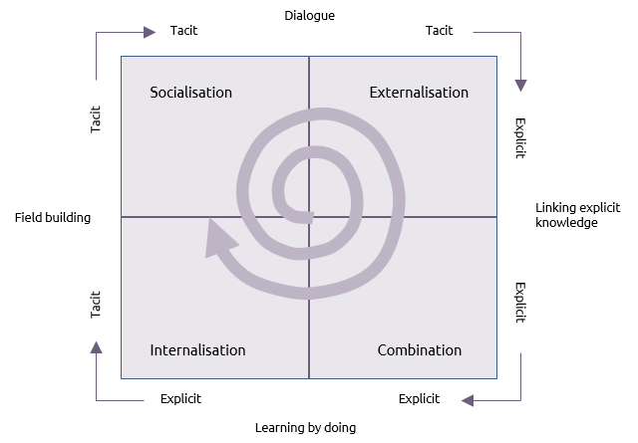
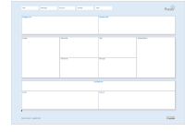

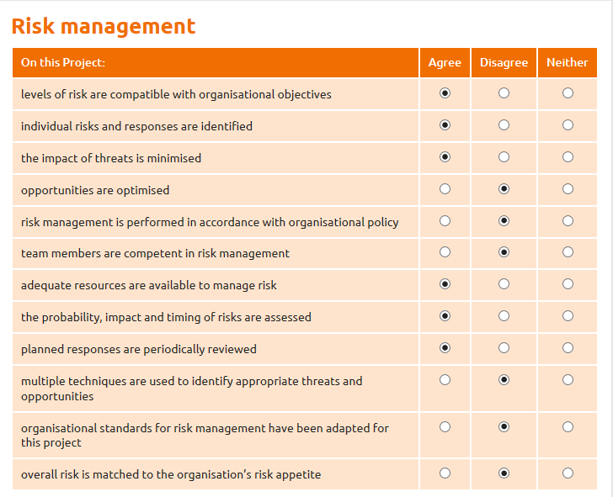


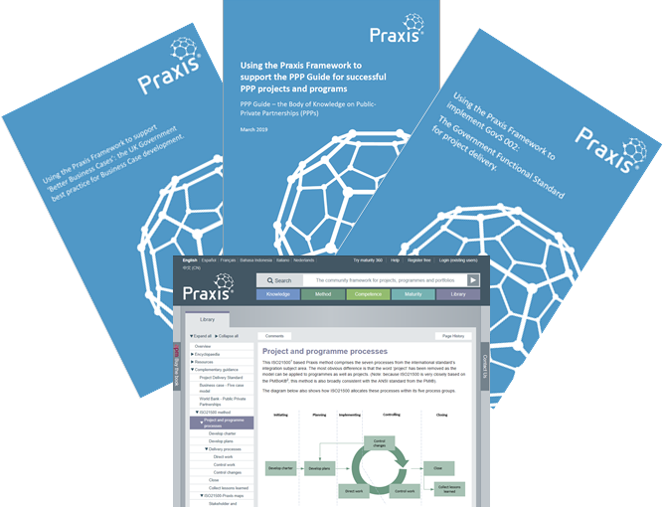
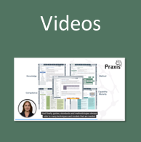
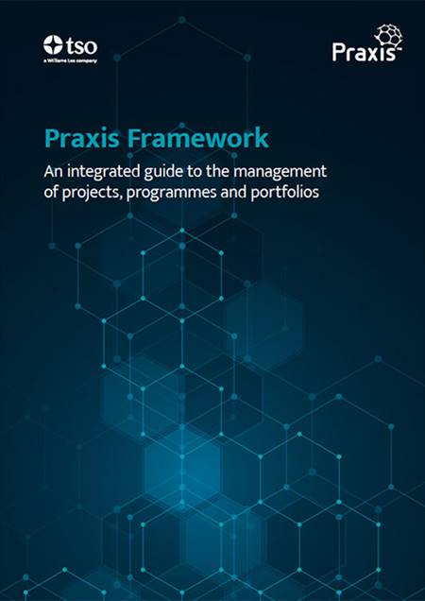
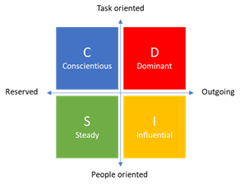
Additional resources
The Praxis Local home page where alternative versions and updates are posted.
An integrated route to efficient and effective project delivery that works on personal, team and organisational levels.
Encyclopaedia
The full Praxis encyclopaedia of tools, techniques and models for project, programme and portfolio management.
Local
Articles and blogs
Articles and blogs arranged by author.
Templates
Blank and annotated templates for all the main documents used in Praxis
Praxis 360^{O}
Explanations of how checklists and 360^{O} assessments can help implement good practice and develop capability maturity.
Glossary
A comparative glossary with terms from all the major guides explained and compared
Certification
Information about Praxis training and certification provided by APMG International.
Complementary guidance
A series of guides to using Praxis with national and international standards.
Book
Team Praxis
Understand how people with different communication styles perceive functions and processes in different ways.
Video guides to the Praxis web site, individual techniques and AI generated comparisons.
Buy the Praxis book from The Stationery Office. Available as a printed book or pdf.

